Slide 1
Title: STUDENT DATABASE SYSTEM
Bruce Ominde and Ryan Omukata
BCS-03-0039/2023 And BCS-05-0428/2023
BSD 111: SDTRUCTURED PROGRAMMING AND ALGORITHMS

Slide 2

Introduction
This project is designed to store students details in a database system.
A user can login into the system in order to view the students details.
The student details is their name, admission number , the course they are undertaking, the current year they are enrolled in and their average GPA.
This program solves the problem of some institutions not having a good system to store their student details.

Slide 3

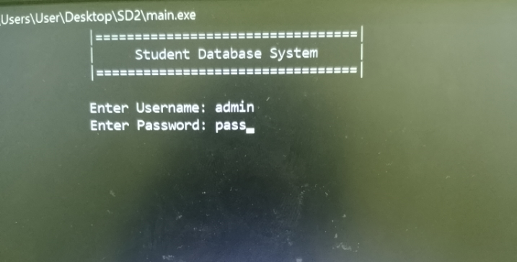
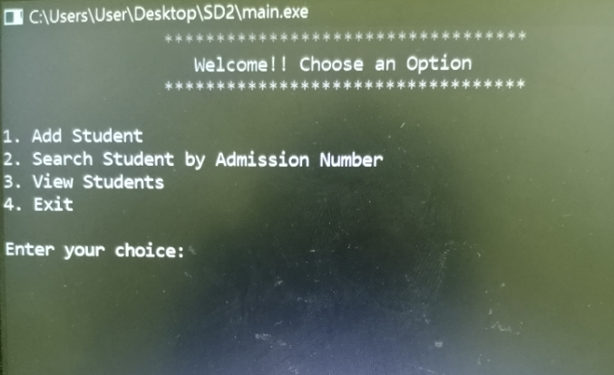
Project Overview
The Main features of the program are:
1.Add Student
2. Search by Admission Number
3. View Enrolled Students
4. Exit
There is also a login system in the program
We have utilized different data structures in and file handling in order to achieve this.

Slide 4
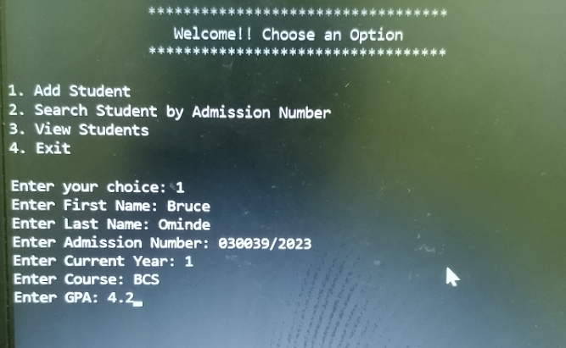
Add Student
The User is required to enter the student details.
Fields: First Name, Last Name, Admission Number, Current Year, Course, GPA
The data is stored in the database file .

Slide 5
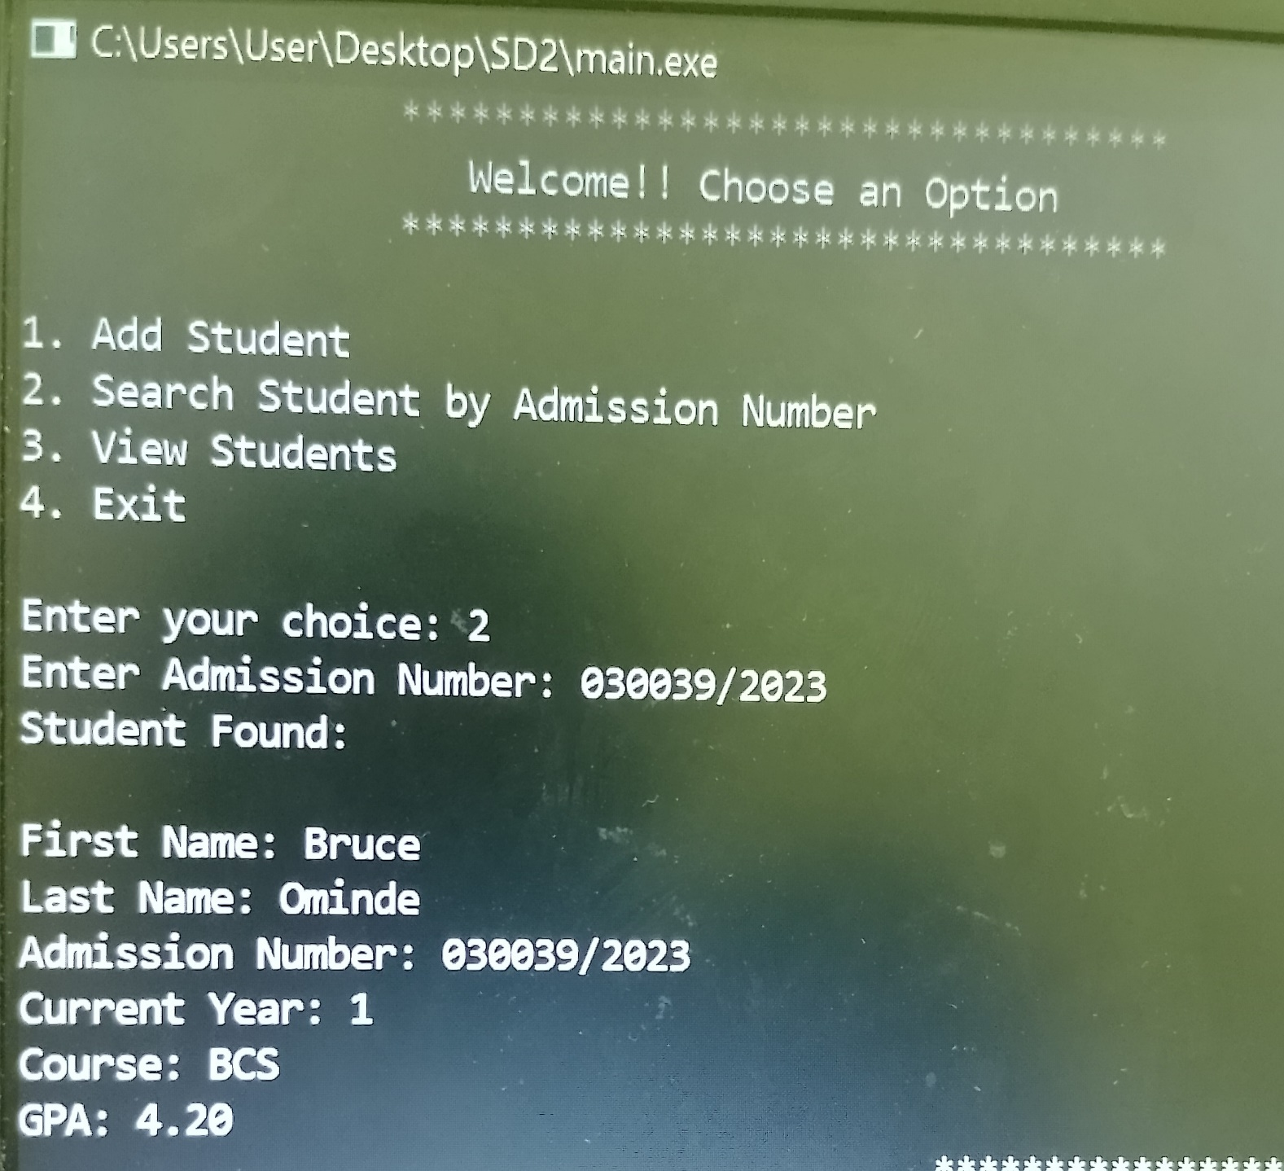
Search student
The User is required to enter the admission number of the student he wishes to search for
The program uses some functions and loops to search through a file in order to find the credentials that matches to those of the entered admission number and displays the student if found

Slide 6
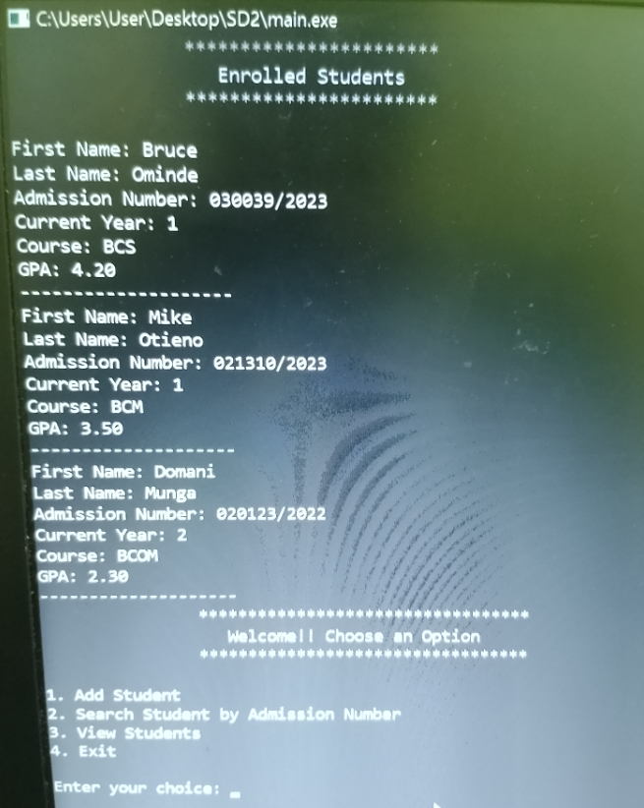
View enrolled students
This option allows the user to see all the enrolled students who are registered in the system

